Slide 1
KC MATHEWS, CFA
CO-chief investment officer

Slide 2
Agenda
CHINA / COVID
GEOPOLITICAL TENSION
INFLATION
FED ACTION
ECONOMIC OUTLOOK
FINANCIAL MARKETS
QUESTIONS

Slide 3
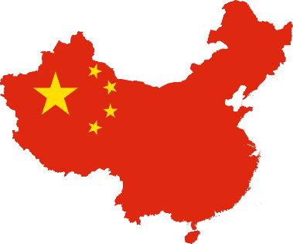
China Reopening
Cement
Coal
Copper
19%
Population
59%
50%
50%
Steel
Pork
Rice
50%
47%
31%
15%
Economy (GDP)
Gold
Corn
Oil
27%
23%
14%
Source: World Economic Forum
Notes:
Make Great Plateau light blue to match forecast.
Chart updated to include Q4 2022 projection. 1-14.

Slide 4
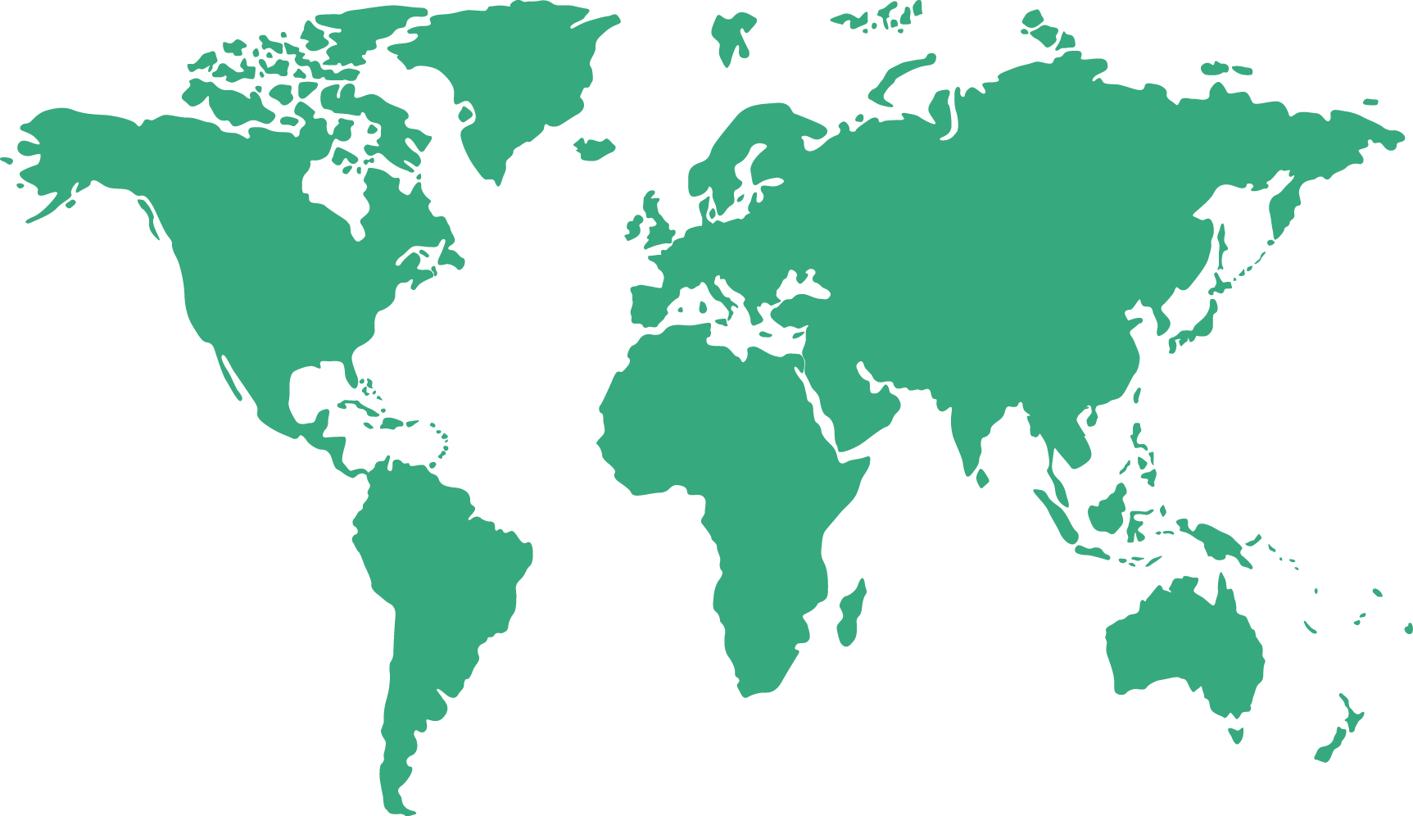
Ongoing Conflicts Around the World
Source: Council on Foreign Relations
Notes:
Make Great Plateau light blue to match forecast.
Chart updated to include Q4 2022 projection. 1-14.

Slide 5
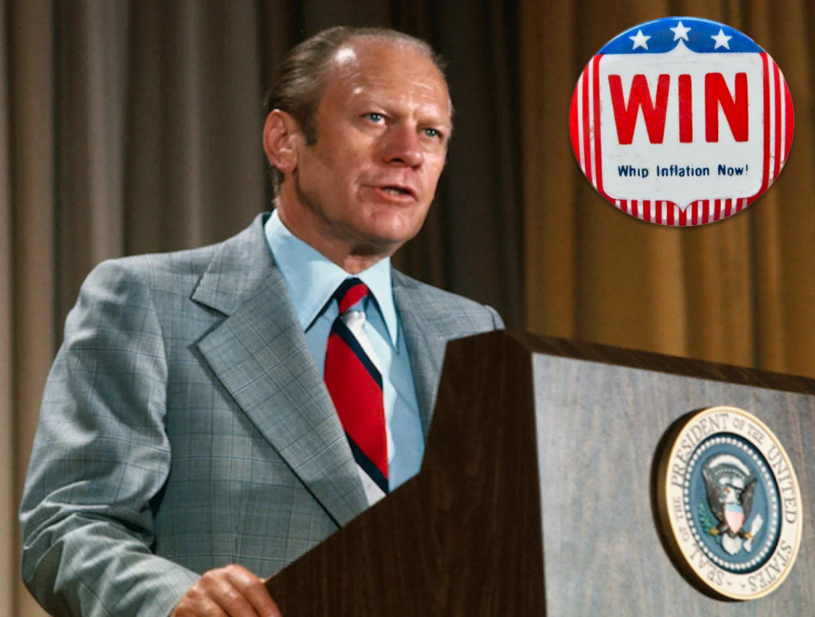
Inflation
Notes:
Make Great Plateau light blue to match forecast.
Chart updated to include Q4 2022 projection. 1-14.

Slide 6
Inflation
Inflation Spike
9
8
CPI
7
Core CPI
6.4%
6
Core PCE
5.6%
5
4.7%
4
Year-over-Year Change (%)
3
Fed Target
2.0% - 2.5%
2
1
0
-1
Dec ’14 | Dec ’15 | Dec ’16 | Dec ’17 | Dec ’18 | Dec ’19 | Dec ’20 | Dec ’21 | Dec ’22
Source: Bloomberg
Recession
Notes:
Make Great Plateau light blue to match forecast.
Chart updated to include Q4 2022 projection. 1-14.

Slide 7
Inflation – Transitory?
Inflation Drivers
6.5%
Sticky?
Contribution to YoY Change in CPI (%)
Transitory?
Source: BLS

Slide 8
Energy Cycle – Historically Boom/Bust
WTI Crude – Price per Barrel
150
125
100
$80.26
75
WTI (NYM $/bbl)
50
25
0
Dec ‘06
Dec ‘08
Dec ‘10
Dec ‘12
Dec ‘14
Dec ‘16
Dec ‘18
Dec ‘20
Dec ‘22
Source: Bloomberg
Recession
Notes:
Make Great Plateau light blue to match forecast.
Chart updated to include Q4 2022 projection. 1-14.

Slide 9
Commodities Hit a Peak
8,961
$ Per Ton
$ Per Bushel
629
$ per MMBtu
$ Per Thousand Board Feet
2.75
403
Source: Bloomberg
Recession
Notes:
Make Great Plateau light blue to match forecast.
Chart updated to include Q4 2022 projection. 1-14.

Slide 10
U.S. Used Car Prices
50
40
30
20
Year-over-Year Change (%)
10
0
-10
-11.6%
2016
2017
2018
2019
2020
2021
Nov ‘22
Source: Bloomberg
Recession
Notes:
Make Great Plateau light blue to match forecast.
Chart updated to include Q4 2022 projection. 1-14.

Slide 11
Housing Cycle
7.8%
8
21
(LS) U.S. Owner's Equivalent Rent
19
7
(RS) Case
-
Shiller Home Price Index
6
17
15
5
13
4
U.S. Owner’s Equivalent Rent YoY (%)
Case-Shiller Home Price Index YoY (%)
11
3
9
2
7
5.7%
1
5
0
3
Nov ’16 | Nov ’17 | Nov ’18 | Nov ’19 | Nov ’20 | Nov ’21 | Nov ‘22
Source: Bloomberg
Recession
Notes:
Make Great Plateau light blue to match forecast.
Chart updated to include Q4 2022 projection. 1-14.

Slide 12
Consumer Inflation Expectations
5.50
1 Yr Expectations
5.00
5
-
10 Yr Expectations
4.50
4.1%
4.00
Percent (%)
3.50
3.00
2.9%
2.50
2.00
Nov ‘17 | Nov ’18 | Nov ’19 | Nov ’20 | Nov ’21 | Nov ‘22
Source: Bloomberg
Recession
Notes:
Make Great Plateau light blue to match forecast.
Chart updated to include Q4 2022 projection. 1-14.

Slide 13
FED ACTION

Slide 14
Fed Moves: Then vs Now
Fed Moves Higher to Slow PCE Increase
- 17 Fed Hikes
- 4.25% Increase
- S&P 500 7.6% per yr.
6
5
Fed Moves Early
4.3%
4
4.1%
Percent (%)
3
2.4%
2
2.0%
1
0
Dec ‘02
Jun ‘03
Dec ‘03
Jun ‘04
Dec ‘04
Jun ‘05
Dec ‘05
Jun ‘06
Dec ‘06
Jun ‘07
Dec ‘07
Fed Target - Upper Bound
Quits Rate
Atl Wage Tracker
Core PCE
Source: Bloomberg
Notes:
Make Great Plateau light blue to match forecast.
Chart updated to include Q4 2022 projection. 1-14.

Slide 15
Fed Moves: Then vs Now
Fed Moved Late
- 7 Fed Hikes
- 4.25% Increase
- S&P 500 -18%
7
Missed Opportunity?
6.1%
6
5
4.7%
4.75%
4
Percent (%)
3
2.7%
2
Fed Moved Late?
1
0
Dec-20
Mar-21
Jun-21
Sep-21
Dec-21
Mar-22
Jun-22
Sep-22
Dec-22
Fed Target - Upper Bound
Quits Rate
Atl Wage Tracker
Core PCE
Source: Bloomberg
Notes:
Make Great Plateau light blue to match forecast.
Chart updated to include Q4 2022 projection. 1-14.

Slide 16
Fastest Tightening Pace Since 1980s
5
Fed Projections
Current Cycle
’04-’06
4
’88-’89
’83-’84
3
’94-’95
Fed Funds Rate Change (%)
’15-’18
2
’99-’00
1
0
0 | 5 | 10 | 15 | 20 | 25 | 30 | 35 | 40
Months Since Hiking Cycle Started
Source: Bloomberg, FRED
Notes:
Make Great Plateau light blue to match forecast.
Chart updated to include Q4 2022 projection. 1-14.

Slide 17
Federal Reserve – Interest Rate Phases
Fed Funds: Fed Estimates
5.00
5.00%
Step-Down, 4.5%
4.00
Pause, Q1
3.00
Percent (%)
2.00
1.00
0.00
Dec ‘21
Jun ‘22
Dec ‘22
Jun ‘23
Dec ‘23
Source: Bloomberg
Notes:
Make Great Plateau light blue to match forecast.
Chart updated to include Q4 2022 projection. 1-14.

Slide 18
Monetary Policy Operates with Long Lags
0.00
Response of Economy and Inflation to a 100 Basis Point Increase in Fed Funds Rate
-0.05
-0.10
-0.15
450 basis points?
A 100 basis point increase takes 7 quarters to digest.
Percentage Change in inflation (%)
-0.20
-0.25
-0.30
-0.35
1 | 2 | 3 | 4 | 5 | 6 | 7 | 8 | 9 | 10 | 11 | 12
Quarters
Source: BCA, Federal Reserve
Notes:
Make Great Plateau light blue to match forecast.
Chart updated to include Q4 2022 projection. 1-14.

Slide 19
ECONOMIC
OUTLOOK

Slide 20
Recession: Leading Economic Index
20
10
0
6-Month Rate of Change
-7.0
-10
-20
-30
Jan ’80 | Jan ’86 | Jan ’92 | Jan ’98 | Jan ’04 | Jan ’10 | Jan ‘17 | Jan ‘23
Source: Bloomberg
Recession
Notes:
Make Great Plateau light blue to match forecast.
Chart updated to include Q4 2022 projection. 1-14.

Slide 21
Treasury Curve Slope
400
3 Mo
-
10 Yr
2 Yr
300
-
10 Yr
200
Slope
100
0
-90 bps
-93 bps
-100
Feb ‘93
Feb ‘01
Feb ‘09
Feb ‘17
Feb ‘23
Source: Bloomberg
Recession
Notes:
Make Great Plateau light blue to match forecast.
Chart updated to include Q4 2022 projection. 1-14.

Slide 22
Consumer Confidence
Consumer Confidence
140
110
100
120
90
100
80
Consumer Confidence Index
70
Consumer Sentiment Index
80
60
60
50
40
40
30
20
20
Dec ‘06
Dec ’08
Dec ‘10
Dec ‘12
Dec ‘14
Dec ‘16
Dec ‘18
Dec ‘20
Dec ‘22
Conference Board Consumer Confidence Index
University of Michigan Consumer Sentiment Index
Source: Bloomberg
Recession
Notes:
Make Great Plateau light blue to match forecast.
Chart updated to include Q4 2022 projection. 1-14.

Slide 23
Manufacturing
ISM Manufacturing Index
Index
1/31/23
47.4
Oct ’94 | Oct ’97 | Oct ’00 | Oct ’03 | Oct ‘06 | Oct ’09 | Oct ’12 | Oct ’15 | Oct ‘18 | Oct ‘21
ISM New Orders Index
Index
1/31/23
42.5
Apr ’95 | Apr ’98 | Apr ’01 | Apr ’04 | Apr ‘07 | Apr ’10 | Apr ‘13 | Apr ’16 | Apr ’19 | Apr ‘22
ISM Non-Manufacturing Index
Index
1/31/23
55.2
Apr ’95 | Apr ’98 | Apr ’01 | Apr ’04 | Apr ‘07 | Apr ’10 | Apr ‘13 | Apr ’16 | Apr ’19 | Apr ‘22
Source: Bloomberg
Recession
Notes:
Make Great Plateau light blue to match forecast.
Chart updated to include Q4 2022 projection. 1-14.

Slide 24
Labor Market – Mixed Signals
Both Unemployment and Payrolls Not Indicating Recession
14
8
6
3.3%
12
4
10
2
0
8
U.S. Payrolls YoY Change
US Unemployment Rate
-2
6
-4
-6
4
3.4%
-8
2
-10
Dec ‘80
Dec ‘83
Dec ‘86
Dec ‘89
Dec ‘92
Dec ‘95
Dec ‘98
Dec ‘01
Dec ‘04
Dec ‘07
Dec ‘10
Dec ‘13
Dec ‘16
Dec ‘19
Dec ‘22
U.S. Unemployment Rate
U.S. Nonfarm Payroll
Source: Bloomberg
Recession
Notes:
Make Great Plateau light blue to match forecast.
Chart updated to include Q4 2022 projection. 1-14.

Slide 25
FINANCIAL
MARKETS

Slide 26
Stocks Lead the Economy
Source: Bloomberg
S&P 500
GDP
Notes:
Make Great Plateau light blue to match forecast.
Chart updated to include Q4 2022 projection. 1-14.

Slide 27
2022-23 vs 1981-82
S&P 500 Index: 2022-23 vs 1981-82
S&P 500 Index: 1981-82
145
4900
4700
135
4500
125
4300
Last Price - 1980's ($)
Last Price - 2020's ($)
4100
115
3900
105
-27%
3700
-25%
95
3500
Dec ‘20
Mar ‘21
Jun ‘21
Sep ‘21
Dec ‘21
Mar ‘22
Jun ‘22
Sep ‘22
Dec ‘22
Mar ‘23
Jun ‘23
Sep ‘23
Dec ‘23
Dec ‘79
Mar ‘80
Jun ‘80
Sep ‘80
Dec ‘80
Mar ‘81
Jun ‘81
Sep ‘81
Dec ‘81
Mar ‘82
Jun ‘82
Sep ‘82
Dec ‘82
S&P 500 Index: 1980 - 1982
SPX 500 Index: 2021 - 2023
Source: Bloomberg
Recession
Notes:
Make Great Plateau light blue to match forecast.
Chart updated to include Q4 2022 projection. 1-14.

Slide 28
Equal Weighted P/E Already Under 15x
S&P 500 Index: P/E Ratio
29
27
25
23
Best P/E Ratio (x)
21
19
18.1x
17
16.6%
16.4%
16.3x
15
15.3%
16.3%
13
14.2%
15.1%
Dec-12
Dec-13
Dec-14
Dec-15
Dec-16
Dec-17
Dec-18
Dec-19
Dec-20
Dec-21
Dec-22
S&P 500 - Cap Weighted
S&P 500 - Equal Weighted
Source: Bloomberg
Recession
Notes:
Make Great Plateau light blue to match forecast.
Chart updated to include Q4 2022 projection. 1-14.

Slide 29
Stocks Do Well After Going into a Recession
S&P 500 Returns Around Recessions
70%
60%
50%
40%
30%
54%
58%
20%
40%
39%
10%
S&P 500 Return
0%
-10%
-
-
29%
24%
-20%
-30%
-40%
Peak to Trough Decline
1-Year Later From Trough
2-Years Later From Trough
Average
Median
Source: Bloomberg
Recession
Notes:
Make Great Plateau light blue to match forecast.
Chart updated to include Q4 2022 projection. 1-14.

Slide 30
Financial Markets: Fixed Income
Rates Peak Near End of Fed Cycles
9
8
Rate Peaks Near End of Fed Cycles
7
6
5
4.50%
Yield (%)
4
3.88%
3
2
1
0
Jun ‘90
Dec ‘92
Jun ‘95
Dec ‘97
Jun ‘00
Dec ‘02
Jun ‘05
Dec ‘07
Jun ‘10
Dec ‘12
Jun ‘15
Dec ‘17
Jun ‘20
Dec ‘22
10-yr Treasury
Fed Funds
Source: Bloomberg
Recession
Notes:
Make Great Plateau light blue to match forecast.
Chart updated to include Q4 2022 projection. 1-14.

Slide 31
Financial Markets: Fixed Income
Peak in Rates?
5.0
4.24% Peak?
4.50%
4.5
4.0
3.88%
3.5
3.0
2.5
2.0
1.5
1.0
0.5
0.0
Sep ‘21
Dec ‘21
Mar ‘22
Jun ‘22
Sep ‘22
Dec ‘22
10-yr Treasury
Fed Funds
Source: Bloomberg
Notes:
Make Great Plateau light blue to match forecast.
Chart updated to include Q4 2022 projection. 1-14.

Slide 32
FORECASTS

Slide 33
2023 Forecast
FUNDAMENTALS OF THE US ECONOMY
2021
2022
2023
Real GDP
5.7%
2.1%
1.0%
Inflation (CPI)
7.0%
6.5%
3.75%
Unemployment
3.9%
3.5%
4.2%
Fed Funds
0.25%
4.50%
5.00%
10
-
Year Treasury
1.51%
3.88%
3.50%
S&P 500
28.7%
-
18.1%
7.0%

Slide 34
QUESTIONS?

Slide 35
Did you know…
You can follow UMB
UMB.com/blog
Thank you!

Slide 36
Disclosure and Important Considerations
UMB Investment Management is a division within UMB Bank, n.a. that manages active portfolios for employee benefit plans, endowments and foundations, fiduciary accounts and individuals. UMB Financial Services, Inc.* is a wholly owned subsidiary of UMB Financial Corporation and an affiliate of UMB Bank, n.a. UMB Bank, n.a., is an affiliate within UMB Financial Corporation.
This report is provided for informational purposes only and contains no investment advice or recommendations to buy or sell any specific securities. Statements in this report are based on the opinions of UMB Investment Management and the information available at the time this report was published.
All opinions represent UMB Investment Management’s judgments as of the date of this report and are subject to change at any time without notice. You should not use this report as a substitute for your own judgment, and you should consult professional advisors before making any tax, legal, financial planning or investment decisions. This report contains no investment recommendations, and you should not interpret the statements in this report as investment, tax, legal, or financial planning advice. UMB Investment Management obtained information used in this report from third-party sources it believes to be reliable, but this information is not necessarily comprehensive and UMB Investment Management does not guarantee that it is accurate.
All investments involve risk, including the possible loss of principal. Past performance is no guarantee of future results. Neither UMB Investment Management nor its affiliates, directors, officers, employees or agents accepts any liability for any loss or damage arising out of your use of all or any part of this report.
“UMB” – Reg. U.S. Pat. & Tm. Off. Copyright © 2023 UMB Financial Corporation. All Rights Reserved.
* Securities offered through UMB Financial Services, Inc. Member FINRA, SIPC, ot the UMB Bank, n.a. Capital Markets Division.
KC Mathews is not registered with UMB Bank, n.a. Capital Markets Division or UMB Financial Services, Inc.
Insurance products offered through UMB Insurance Inc.
You may not have an account with all of these entities.
Contact your UMB representative if you have any questions.
Securities and Insurance products are:
Not FDIC Insured • No Bank Guarantee • Not a Deposit • Not Insured by any Government Agency • May Lose Value

Slide 37
Capital Markets Division Disclosure
This communication is provided for informational purposes only. UMB Bank, n.a. and UMB Financial Corporation are not liable for any errors, omissions, or misstatements. This is not an offer or solicitation for the purchase or sale of any financial instrument, nor a solicitation to participate in any trading strategy, nor an official confirmation of any transaction. The information is believed to be reliable, but we do not warrant its completeness or accuracy. Past performance is no indication of future results. The numbers cited are for illustrative purposes only. UMB Financial Corporation, its affiliates, and its employees are not in the business of providing tax or legal advice. Any materials or tax‐related statements are not intended or written to be used, and cannot be used or relied upon, by any such taxpayer for the purpose of avoiding tax penalties. Any such taxpayer should seek advice based on the taxpayer's particular circumstances from an independent tax advisor. The opinions expressed herein are those of the author and do not necessarily represent the opinions of UMB Bank, n.a. or UMB Financial Corporation.
Products, Services and Securities offered through UMB Bank, n.a. Capital Markets Division are:
Not FDIC Insured, May Lose Value, Not Bank Guaranteed.
UMB Bank, n.a.
Capital Markets Division
928 Grand Blvd 13th Floor
Kansas City, MO 64106
866.651.9262

Slide 38
CONNECT WITH US
Wealth Management 1.800.545.6101
UMB Bank, Capital Markets Division 1.866.651.9262
UMB.com/CapitalMarkets
To receive the latest economic content, invites to webinars and more, visit UMB.com/PrivateWealthManagement and subscribe.

